Slide 1

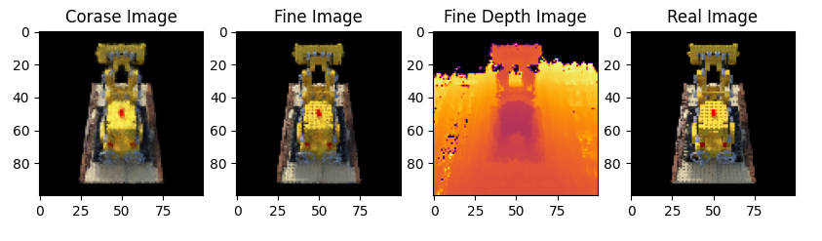
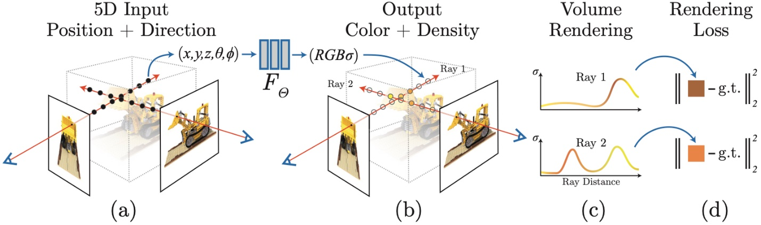
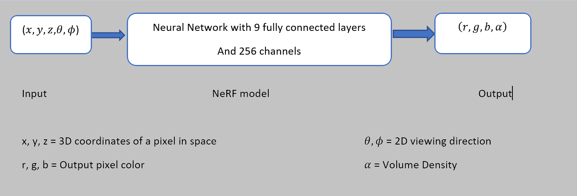
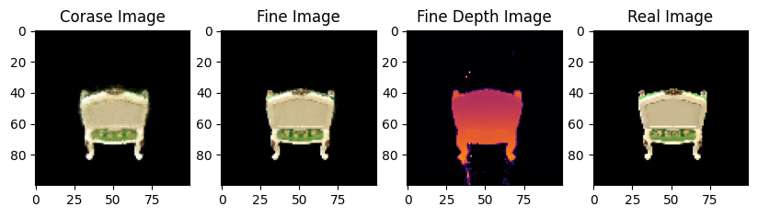
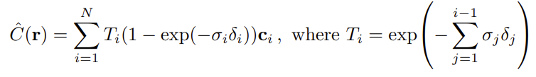
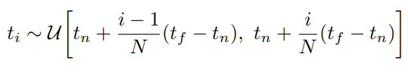
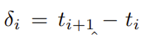
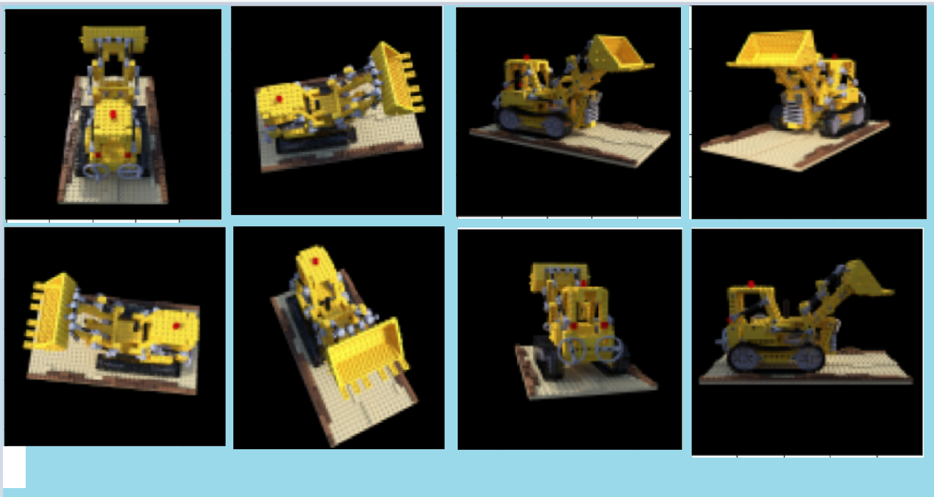
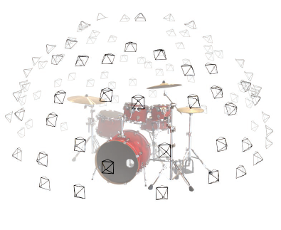

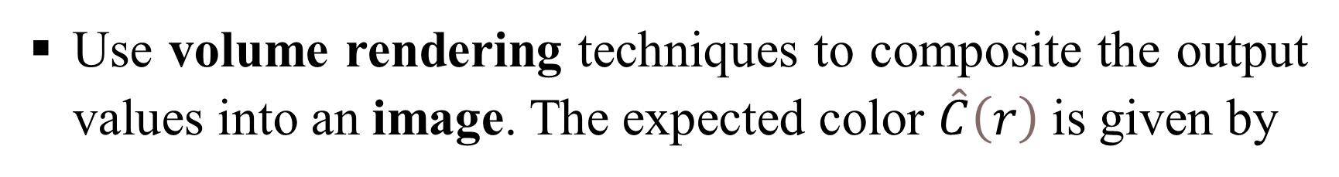
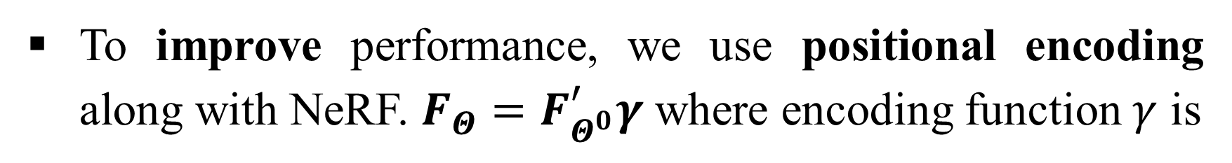

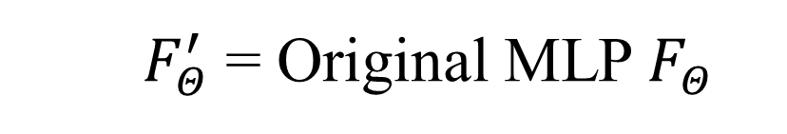

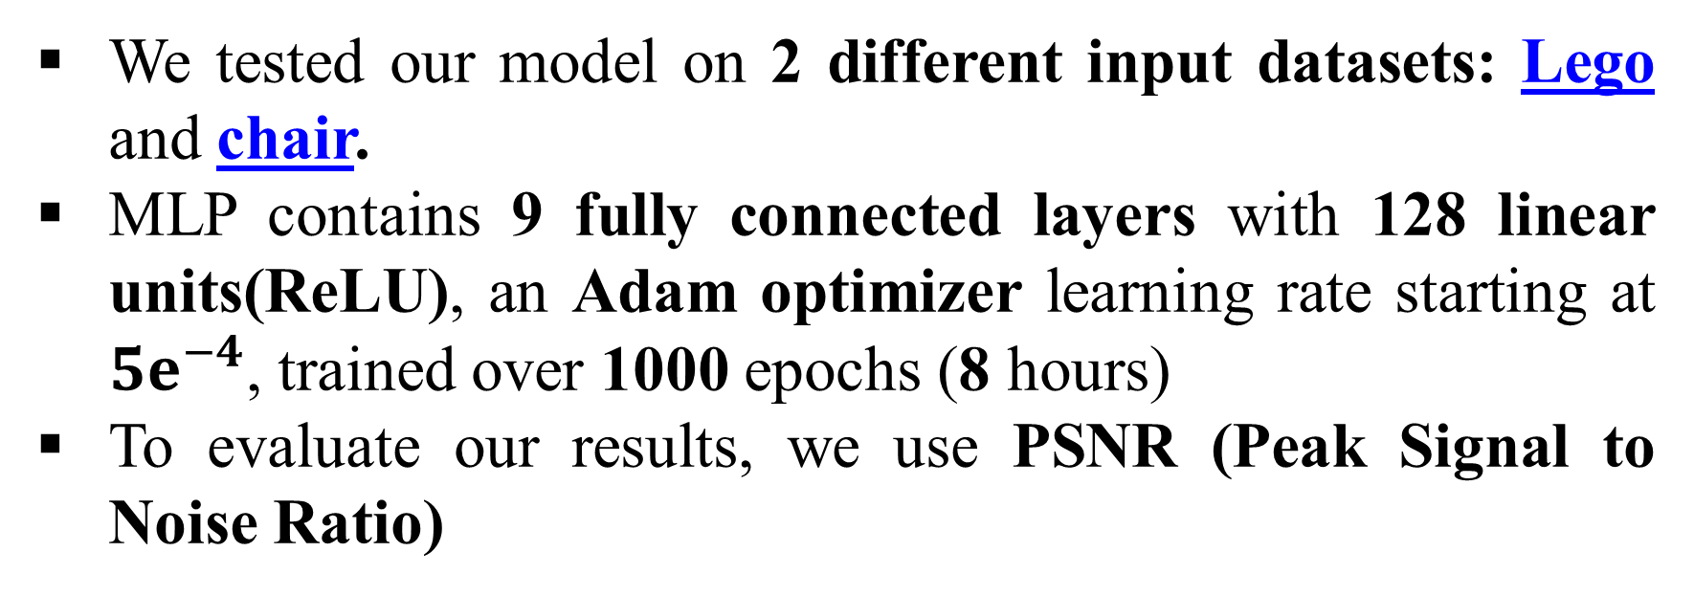
NeRF: Representing Scenes as Neural Radiance Fields for View Synthesis
Aashay Gondalia, Sai Morapakala, Harsh Atha Luddy School of Informatics and Computing, Indiana University
1. Motivation
3. Modeling Egocentric Interactions
5. Results
1. Motivation
3. Methodology
5. Results
The goal is to get a 3D computerized representation of a scene that can be correctly rendered from any angle.
NeRF (Neural Radiance Fields) synthesizes views by taking 5D coordinates as inputs and generates volume density and output colors.
Given 5D coordinates $(x,y,z,θ,φ)$ as input.
We feed these values into an MLP to produce a color and volume density. $F_{Θ}:\left(x,d\right)→\left(c,σ\right)$
Coarse+fine
A. Output and depth image of Lego dataset.
An overview of our neural radiance field scene representation and differentiable rendering procedure
Coarse+fine
Use volume rendering techniques to composite the output values into an image. The expected color $\hat{C}\left(r\right)$ is given by
B. Output and depth image of Chair dataset.
Rudimentary Explanation of the process
The goal is to use this in applications like City Planning, Archaeology, Augmented Reality, Medicine and Gaming.
a. Predicted Image b. Depth map c. Iterations vs Loss Plot
Above: Image A shows comparison of coarse, fine , fine depth image and ground truth for Lego dataset. Image B shows same comparison for chair dataset. GIF shows comparison for only coarse Lego and loss plot.
Dataset (Method) | No. of iterations | PSNR Values
Lego (Coarse ours) | 1000 | 21.75*
SRN | ------ | 22.6
Lego (C+F ours) | 1000 | 23.73*
Chair (Ours) | 1000 | 24.45*
LLFF | ------ | 24.88
Average (NeRF) | 100k-300k | 31.01
$$r\left(t\right)=o+t\left(d\right) for t=3$$
Rays from all pixels in 3D
To improve performance, we use positional encoding along with NeRF. $F_{Θ}=F_{Θ^{0}}^{′}γ$ where encoding function $γ$ is
Input images of same scene/object captured from multiple angles
We attempt to replicate the volume rendering and positional encoding techniques of this paper to generate novel views of input images.
$F_{Θ}^{′}$ = Original MLP $F_{Θ}$
Right: Comparison of Iterations and PSNR Values of different datasets and methods in order of PSNR values (asc).
*PSNR Values taken from validation dataset
4. Experiments
2. Challenges
We tested our model on 2 different input datasets: Lego and chair.
MLP contains 9 fully connected layers with 128 linear units(ReLU), an Adam optimizer learning rate starting at $5ⅇ^{−4}$, trained over 1000 epochs (8 hours)
To evaluate our results, we use PSNR (Peak Signal to Noise Ratio)
6. Future Work
Training the model on a set of fewer images (~25-50) as compared to the usual (100+) proved challenging in obtaining better results.
Training only the coarse model on new hyperparameters over 100k-300k iterations (2 days as given in paper) was difficult due to memory and computational constraints.
6. Future Work
Use an ensemble of tiny MLPs to speed up the training process.
Improve performance by training on a set of fewer input images.
Expand scope to render natural datasets.
Acknowledgments: This work was inspired by the original paper of NeRF by Mildenhall et al.

